Slide 1
Genome Analysis Project
Paper 1: Zhang et al.
Module code: 1MB462
Choi Tsang

Slide 2
Paper 1: Zhang et al.
Background:
This project is based on a paper study by Zhang et al (2017)
Briefly, this paper is about a gram positive bacterium called Enterococcus faecium which has an involvement in human gastrointestinal tract.
It frequently causes bloodstream infections in patients. This study explores the contribution and identifies the genes involved in the growth of E.faecium.
For my project I mainly used PacBio data.

Slide 3
Canu: DNA Assembly
Firstly, we need to assembly the PacBio data;
Canu is a de novo shotgun method that looks at the whole genome, and it is designed for long read sequencing;
Canu is the most appropriate for PacBio data as well as Oxford Nanopore;
Canu consists of three stages: correction, trimming and assembly.

Slide 4
Canu Results
Based on the results there is a 59.75% of coverage in reads;
The repeat count is 2.24%;
The expected contigs was 15 but I got the result of 9 contigs;
Bubbles: 1 sequence (total length 9787 bp.)

Slide 5
Quast: Assembly Evaluation
QUAST is python based;
It can work both with and without a reference genome to compare with, and accepts multiple assemblies
Input data is the results of the contig file from Canu.

Slide 6
Prokka: Assembly Annotation
Prokka annotates a combination of structural and functional features, by identifying as well as predicting genetic elements that are encoded;
Results:
Count: 3126
The total annotated regions: 142979
Protein coding genes: 140228
GC percentage: 38.47

Slide 7
Synteny Analysis
The purpose for synteny analysis is to test and observe for homologous genes against different species;
Firstly, I researched the bacterium Enterococcus faecium on NBCI and looked at its taxonomy for any related species;
Enterococcus durans was picked;
Aligned Enterococcus durans against my own assembly using blastn.

Slide 8
Synteny Analysis Results
Showed a 97.89% percentage identity - significant match;
When visualised on ACT:
Number of bases: 674286
GC percentage: 39.65
For comparison, aligned the complete E.faecium against E.durans species and showed 92.98% percentage identity.

Slide 9
BWA: RNA Mapping
Mapping low-divergent sequences against a large reference genome
Results : Total amount of reads mapped:
BH Trimmed paired reads (ERR1797972): 98.66%
BH Trimmed paired reads (ERR1797973): 98.73%
BH Timmed paired reads (ERR1797974): 98.71%
Serum Trimmed paired reads (ERR1797969): 98.40% and 0.01% singleton
Serum Trimmed paired reads (ERR1797970): 98.51% and 0.01% singleton
Serum Trimmed paired reads (ERR1797971): 98.44% and 0.01% singleton

Slide 10
HTSeq: Differential expression
After mapping HTSeq can be carried out to count the number of RNA reads;
This step is essential for observing particular gene expressions and for further analysis of differential expression analysis;
Input data: results output from the BWA RNA mapping reads.

Slide 11
HTSeq Results:
This step is essential for observing particular gene expressions;
Results:
All 6 files contained no_feature of over 900000;
Meaning that HTSeq found a lot of reads that could not be mapped properly
Maybe missing mates.

Slide 12
DESeq2: Differential expression
This method estimates the variance mean dependence in the counted reads against the gene features under the different conditions that were tested;
DESeq2 uses a log2 value method;
For this analysis, in order to compare the gene expression I used the results from the HTSeq analysis.

Slide 13
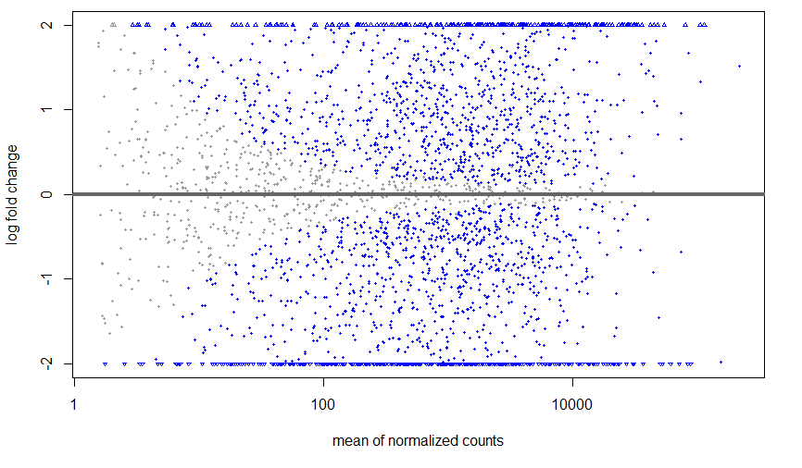
DESeq2 Results
MA Graph:
Notes:
significance with a p value of <0.05 among the two different conditions (BH and Serum).
A range of graphs were created to observe significance, for example, figure 1 (MA plot) shows genes with a log fold change value (plotted on the y-axis) and the other presents the number of RNA reads found, these RNA reads have been normalised by DESeq for comparison (plotted on the x-axis). In further detail, each gene is represented by a dot and the genes with an adjusted p value of below 0.1 are shown in the blue colour. We can see from this graph and the way the grey dots narrow inwards, that the log changes in the genes with a low count have a high variable count. Overall, despite a significant difference between the two conditions we can still improve on this dataset as the results do dependent on a number of variables like the number of RNA reads, and the amount of noise the data has.

Slide 14
Conclusion
There were some differences to paper 1: Zhang et al.
Could be from missing data;
The analysis process;
Technical errors.
Overall, it was very similar to the results in the paper and provides a good base for more future analysis of this dataset

Slide 15
Thank you for listening!

